Slide 1
Face Recognition Python Project
Overview : This project explores the implementation of face recognition using Python, emphasizing the utilization of cutting-edge technologies to detect and recognize faces in images. The presentation will provide insights into the project's objectives, methodologies, and showcase its outcomes.
Name : Akash Yadav N
Date : 22-01-2024

Slide 2
Introduction to Face Recognition:
Definition: Face recognition is a technology that identifies or verifies individuals by analyzing and comparing patterns based on facial features.
Key Components: Involves capturing, analyzing, and comparing facial patterns for identification purposes.
Enhanced Security: Used for access control and identity verification in secure environments.
Convenience: Enables seamless authentication without the need for physical tokens or passwords.
Personalization: Applied in personal devices for customizing user experiences.
Law Enforcement: Aids in criminal investigations by identifying individuals from surveillance footage.
Applications of Face Recognition:
Security Systems: Access control in buildings, airports, and restricted areas.
Mobile Devices: Unlocking smartphones and ensuring secure transactions.
Surveillance: Monitoring public spaces for security and safety.
Retail: Personalized customer experiences and behavior analysis.
Healthcare: Patient identification and medical record management.

Slide 3


Objective of the Face Recognition Project:
Primary Goal: Develop a robust face recognition system using Python and OpenCV.
Specific Tasks:
Detect and identify faces in images and/or real-time video streams.
Implement an efficient algorithm for accurate face recognition.
Showcase the potential applications and benefits of the developed system.

Slide 4
Problem Statement:
Challenge: Overcome limitations in traditional identification methods.
Solution: Provide a reliable, non-intrusive, and efficient face recognition solution applicable in diverse scenarios.
Key Accomplishment
Accurate Detection: Achieve high accuracy in detecting faces within images or video frames.
Effective Recognition: Develop a recognition algorithm capable of distinguishing individuals with precision.
Applicability: Demonstrate the practical application of face recognition in real-world scenarios.

Slide 5
Methodology for Face Recognition\Haar Cascade Classifier
Image Acquisition: Obtain images or video frames containing faces for analysis.
Preprocessing: Enhance image quality, adjust lighting, and normalize facial features.
Feature Extraction: Extract relevant facial features, such as key landmarks.
Algorithm Selection: Utilize the Haar Cascade classifier for initial face detection.
Deep Learning (Optional): Explore deep learning techniques for advanced recognition.
Description: Haar Cascades are effective object detection algorithms used for face detection.
Training: Trained on positive and negative samples to recognize patterns indicative of faces.
Cascade Structure: Hierarchical structure for efficient detection at multiple scales.
Integration with Python and OpenCV:
Implementation: Use Python programming language and OpenCV library for seamless integration.
Flexibility: Leverage OpenCV's rich set of tools and functionalities for image processing.

Slide 6
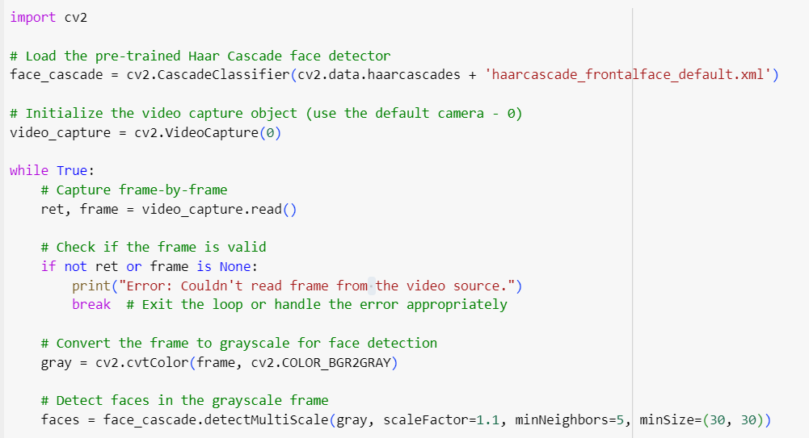
Code:

Slide 7
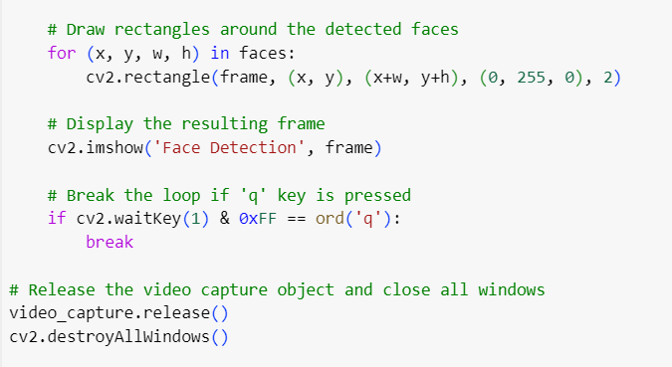
Code:

Slide 8
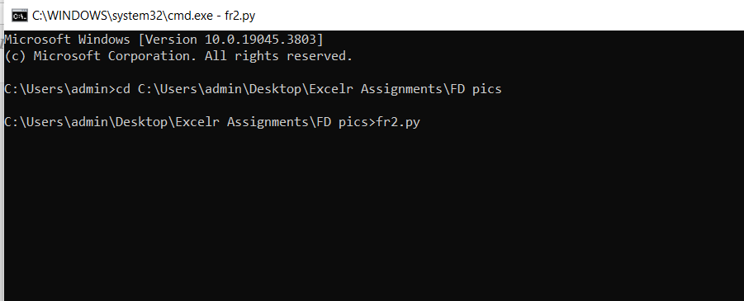
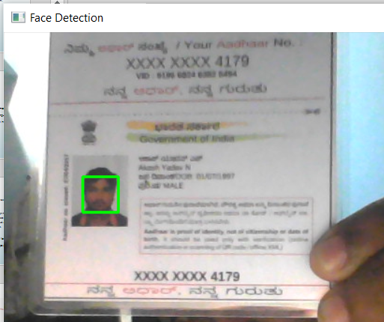
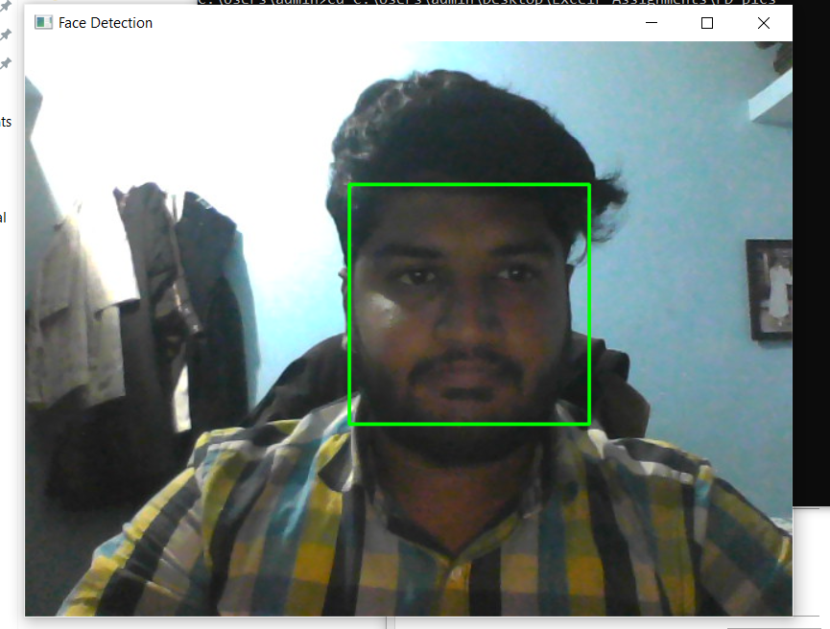
Result:

Slide 9
Challenges Faced During the Project:
Variability in Lighting Conditions: Faces captured under diverse lighting scenarios.
Pose and Orientation: Recognition difficulties with non-frontal poses.
Complex Backgrounds: Interference from complex or cluttered backgrounds.
Limited Dataset: Challenges in achieving robustness with a limited training dataset.

Slide 10
Conclusion:
Achievements: Developed a robust face recognition system using Python and OpenCV.
Accuracy: Attained high accuracy in face detection and recognition tasks.
Flexibility: Utilized a blend of Haar Cascade classifier and optional deep learning algorithms.
Challenges Addressed: Successfully tackled challenges such as lighting variability, pose, and complex backgrounds.
Streamlined Processes: Simplifies identification processes in diverse scenarios.
User-Friendly: Enhances user experience through personalized interactions.
Future Potential: Lays the foundation for future enhancements and applications in the field of face recognition.

Slide 11
Thank You

